Slide 1
Unit 5: Week 6
Kindergarten

Slide 2
Copyright © Savvas Learning Company LLC. All Rights Reserved.
This publication is protected by copyright, and permission should be obtained from the publisher prior to any prohibited reproduction, storage in a retrieval system, or transmission in any form or by any means, electronic, mechanical, photocopying, recording, or otherwise. For information regarding permissions, request forms, and the appropriate contacts within the Savvas Learning Company Rights Management group, please send your query to:
Savvas Learning Company LLC, 15 East Midland Avenue, Paramus, NJ 07652
or
k12learningpermissions@savvas.com
myView Literacy® is an exclusive trademark of Savvas Learning Company LLC in the U.S. and/or other countries.

Slide 3
Lesson 1

Slide 4
Page
200, 201
Compare Across Texts
Tell one detail about weather from each text.
Notes:
In this unit, students learned about weather. Remind students of the unit theme, Outside My Door, and the Essential Question: What can we learn from the weather? Remind students that all of the texts they have read during the unit relate to the theme of weather.
Have student pairs go back and review pictures and sentences from each text in this unit. Ask them to tell one detail about weather that they learned from each text.

Slide 5
Page
200, 201
Compare Across Texts
Think about what we can learn from weather.
Write or draw your response.
Notes:
Once again, remind students that all of the unit readings are connected by the unit theme, Outside My Door. Then use the questions below to help students compare themes, topics, and genres across texts.
What do Weather Around the World, Tornado Action Plan, and Blizzard Action Plan have in common? (Possible response: All three texts discuss how humans deal with extreme weather.)
How does A Desert in Bloom show readers a special place in our world? What makes this place special? (Possible response: This text shows readers the desert, which is special because flowers are able to grow there, even though it is a hot, dry place.)
How are the meanings of the repeated phrases (“it’s raining” and “the sun is shining”) in the poetry collection important to the plants? (Possible response: Growing things, such as plants, need both rain and shining sun in order to grow.)
Have students write or draw their responses to the Essential Question: What can we learn from the weather?
Tell students to look back over the texts that they have read in this unit in order to answer this question. Explain that this week students will work on a research project where they will choose a favorite season or type of weather. After conducting research about their favorite season or type of weather, students will write a poem or song explaining why it is so great.

Slide 6
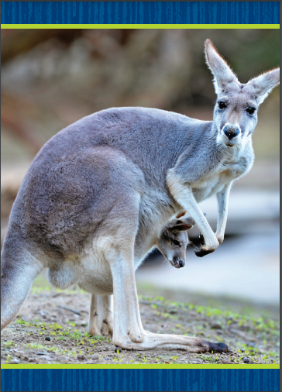
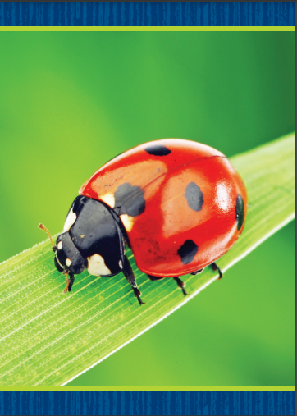
Phonological Awareness
Notes:
Today we are going to put together syllables to make words. Let’s say the word sun together. Clap for each syllable: sun (clap). How many syllables are in sun? Students should say one.
Now let’s say the word rise together. Clap for each syllable: rise (clap). How many syllables are in rise? Students should say one.
What new word do we make if we put the syllables sun and rise together? Students should say sunrise. Now let’s segment the syllables: sun (pause) rise. Let’s put the word back together: sunrise.
Continue the activity with the words sunset, pumpkin, and contest.
Display the astronaut Picture Card. Have students segment and blend the syllables in the word. Continue with the bubble, kangaroo, and ladybug Picture Cards. Click path -> Table of Contents -> Unit 5 Week 6 Project-Based Inquiry -> Lesson 1

Slide 7
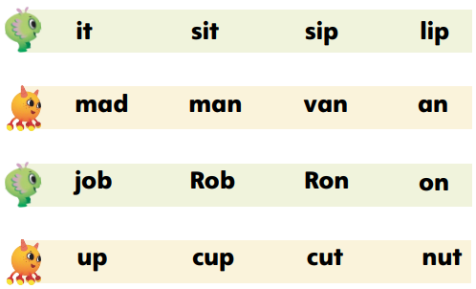
Page 202
Phonics
can
cane
mane
man
Notes:
Tell students that today they will read some words. The words we read will all include sounds we already have learned.
Write the following words on the board: can, cane, mane, man. Let’s read the words. What letter was added to can to make the word cane? The letter e was added to can. What letter was changed to make the word mane? The letter c was changed to m. Continue with mane and man.
Have students turn to p. 202 in the Student Interactive. Let’s read the first row of words together: it, sit, sip, lip. What letter was added to it to make sit? What letter was changed in sit to make sip? Students should say an s was added to it to make the word sit and the letter t was changed to p to make the word sip. Have students explain what letter was changed in sip to make lip.
Guide students as they use letter-sound relationships to decode the words on p. 202, and then talk about what letters were changed, added, or deleted to make new words.

Slide 8
High-Frequency Words
say
under
no
Notes:
Write the high-frequency words say, under, and no.
Show students familiar letter sounds, such as s/s/ and n/n/, in these words.
Point to the word say and read it.
Have students identify the word say by pointing to it, and then have them read it.
Repeat for under and no.

Slide 9
Spelling
I clap to the music.
I will open the can.
I see a big ox.
Please sit next to the tree.
There is no way.
What did you say?
Notes:
(Note: Move the orange boxes to cover each bold spelling word before you read aloud the words and sentences.)
Read aloud the words and sentences. Have students spell the words with the sound /kw/, the other spelling words, and the two high-frequency words.
I clap to the music.
I will open the can.
I see a big ox.
Please sit next to the tree.
There is no way.
What did you say?
Reveal the spelling word and have students check their work.

Slide 10
Page
212
Inquire – Introduce the Project
Talk about weather and seasons with your partner.
Circle the weather and seasons you like best.
Notes:
Explain to students that this week they will work collaboratively with others as they research seasons and weather, following rules for discussion, including taking turns. They will develop a research plan and write a persuasive text, which will be a poem or song, about their favorite season or type of weather.
Say: Today you will choose a type of weather or a favorite season. For example, maybe you will want to research hurricanes or tornadoes. Maybe you will want to read more about snow, ice, and cold weather. These are some things to think about when choosing your topic:
What season or weather do you see in the pictures?
Which one is your favorite? Why?
Have student pairs look at the pictures on p. 212 in the Student Interactive. Have them use the pictures to talk about weather and seasons. Make sure students follow rules for discussions, such as taking turns, as they work collaboratively with others. Have pairs circle the types of weather and seasons they like the best. If needed, assist students in writing their responses on the line.

Slide 11
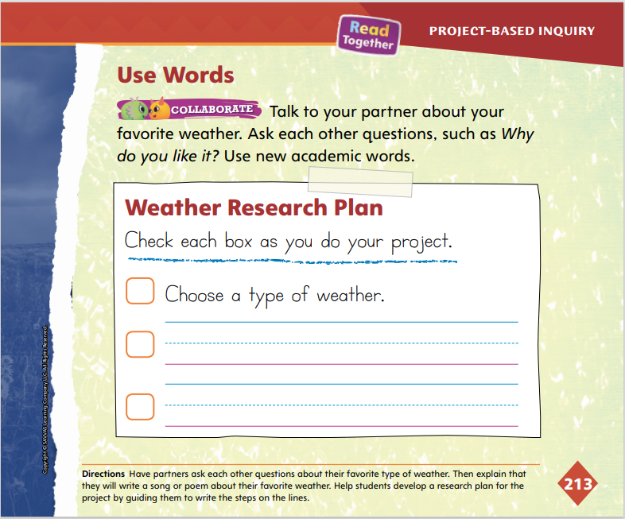
Page
213
Inquire – Generate Questions
Turn to page 213 in your Student Interactive.
Fill in the steps of your research plan.
Notes:
On p. 213 in the Student Interactive, show students the lines where they can fill in the steps of their research plan.
Guide students to understand that research is based on asking questions and finding answers to those questions.
For differentiated support:
Intervention If students struggle to talk about weather, provide additional pictures of different seasons and weather events. Use the Academic Vocabulary words in prompts to help students tell about what they see. For example, ask: What is the effect of this kind of weather? What kind of weather is extreme?
Invite students to write or draw what they already know about weather and the different seasons. Have them share their ideas with a partner and use the Academic Vocabulary words as they tell about their writing or drawing.
Once students have chosen a topic, they can check off the first item in the Weather Research Plan. Explain that next they will look at a student model and then research the type of weather or season they chose.

Slide 12
Page
212, 213
Inquire – Academic Vocabulary
Turn to pages 212-213 in your Student Interactive.
Talk about the picture using your Academic Vocabulary.
Notes:
Remind students that the Academic Vocabulary words relate to the unit theme, Outside My Door. Review the words again: effect, measure, prepare, and extreme.
Have students use these words to discuss their favorite weather.

Slide 13
Lesson 2

Slide 14
Page 203
Phonics
I have a ______ puppy.
cut cute
I will ______ the bus.
rid ride
Notes:
Tell students that today they will read some words. The words we read will all include sounds we already have learned.
Write the following sentence on the board: I have a _____ puppy. Then write the words cut and cute. Let’s read the sentence and find the word that finishes the sentence.
Read the sentence twice, replacing the blank with cut the first time and cute the second time. Have students tell you which sentence makes sense. Students should say: I have a cute puppy.
Have students turn to p. 203 in the Student Interactive. Let’s read the first sentence with a missing word. Then let’s read the word choices. Which word fits in the blank of the sentence: I will ___ the bus. Is it rid or ride? Students should say ride. Guide students as they circle ride and read the sentence again with ride in it.

Slide 15
Page 203
Apply
Turn to page 203 in your Student Interactive.
Circle the word that best completes the sentence.
Notes:
Have students finish p. 203 in the Student Interactive by circling the word that best completes each sentence.

Slide 16
High-Frequency Words
say
under
no
Notes:
Tell students that high frequency words are words that they will hear and see over and over in texts.
Write and then read the words say, under, and no.
Have students read the words with you.
Have students clap for each letter as they spell the words.

Slide 17
Page 204
Spelling
Turn to page 204 in your Student Interactive and complete the activity.
Notes:
Explain that words with VC, CVC, and CCVC patterns have short vowel sounds.
Have students turn to p. 204 in the Student Interactive. Say the words aloud. Have students tell you which word pattern each word follows or whether it is a high-frequency word.
Have students complete the activity on p. 204. Have them write the VC, CVC, and CVCC words in the first column and the high-frequency words in the second column.

Slide 18
Page 214
Explore and Plan – Persuasive Text
Turn to page 214 in your Student Interactive.
Notes:
Have students turn to p. 214 in the Student Interactive. Remind students that they have learned about persuasive texts in Units 1 and 3. Now they will learn how poems can be persuasive. Use the Model and Practice below to help students explore the characteristics of persuasive writing, specifically persuasive poetry.
Say: In Units 1 and 3, we learned how writers sometimes write to make their readers think or do something. This is called persuasive writing, and we have both read and written persuasive texts. We wrote about museums, and we wrote about our favorite stories. In persuasive texts, writers tell their opinion, or what they think or feel. They give details and reasons to support their opinions. Poems can be a type of persuasive text. Let’s look at the picture and read the poem on p. 214. What is the poet trying to make us think about rainy days? Read the poem aloud to the class.

Slide 19
Page 214
Apply
Turn to page 214 in your Student Interactive.
Circle the opinion.
Underline the reasons.
Notes:
Discuss with students the words in the poem that are used to persuade the reader. Guide them to understand that certain words show the poet’s opinion and feelings about rainy days.
Ask students to circle the opinion and find and underline the reasons in the poem.

Slide 20
Check For Understanding
Let’s think about your audience for your poem.
Who will listen to my poem?
What words can I use to make my audience agree with my opinion?
Notes:
Explain to students that authors write with a certain audience in mind.
Have students consider the audience for their persuasive text. Ask questions to help students think about audience, such as Who will listen to my poem? What words can I use to make my audience agree with my opinion? Record students’ responses.
Remind students to think about their audience as they write their persuasive poems.
Remind students that they will research their favorite weather or season by searching online. Tell students that they will learn how to find information they can use in their persuasive poems.

Slide 21
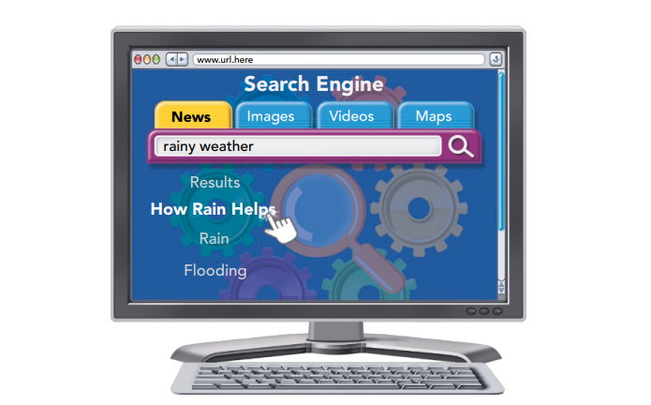
Page 215
Conduct Research
With your partner, discuss how you will use a search engine to gather information.
Notes:
Explain to students that there are many places to gather the information they need to research weather. Point to the picture on p. 215 in the Student Interactive, and have a student volunteer identify the picture. Use the Model and Practice to explain how students can search online.
Say: Looking online is one way to research information. Look at the picture of a search engine on p. 215. A search engine is a way to find information on the Internet. You can type words in the search box. These words should be about your topic. For example, this person wants to know more about rainy weather, so that is what is typed in the box. Now work with a partner to talk about the picture and to come up with questions about your favorite weather or season. For example: How cold does it have to be for snow? What are fun things to do in fall? What season has the hottest weather? Explain that they can look for answers to these questions online.
Help students as they generate ideas for their search by asking them questions, such as: What do you want to learn about your topic? What do you like about your topic? Use students’ responses to suggest specific areas to research.

Slide 22
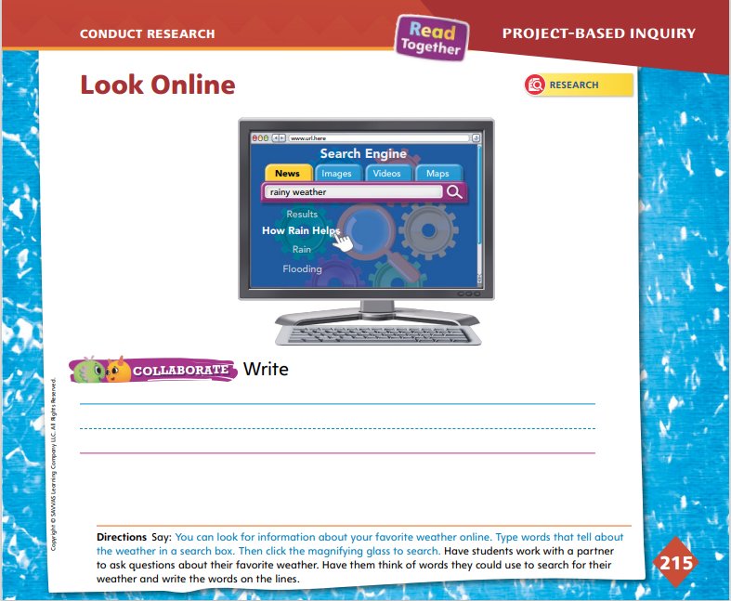
Page 215
Conduct Research
Turn to page 215 in your Student Interactive.
Write words that you could use to research on the lines.
Notes:
Have students collaborate with their partners to generate questions for inquiry. Make sure students’ questions are about their favorite weather or season. Have students talk about their questions and then write words that they could use to search online.
For differentiated support:
Provide sentence frames for students who might be struggling with their own questions of inquiry: I like this type of weather: ______. This word describes the weather I like: ______. Also, students may draw something they are interested in learning more about and then have you help them frame their idea as a question.
Students who easily discuss inquiry questions can write their questions on a sheet of paper. They may want to illustrate their questions and underline key words for their research.
Have students return to the Weather Research Plan on p. 213 in the Student Interactive. Have them check the box on their plan where they wrote that they should research weather. Explain that next they will take notes on their topics. Then they can start writing.

Slide 23
Lesson 3

Slide 24
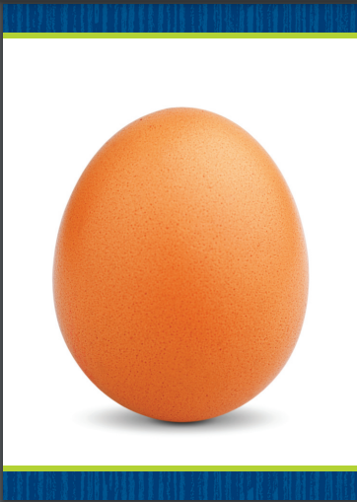
Phonological Awareness
egg
in
_eg
_in
_eg
_in
Notes:
Tell students that today they will add sounds to words to make new words. Display the egg Picture Card. This picture shows the word egg. Say the word with me: egg. Now listen as I add the sound /l/ to the beginning of /e/ /g/: /l/ -eg. What is the new word? (leg) Have students add another sound to the beginning of /e/ /g/ with you. Now let’s try adding the sound /m/. Say the new word with me: /m/ -eg. The new word is Meg. Click path -> Table of Contents -> Unit 5 Week 6 Project-Based Inquiry -> Lesson 3
Say the word in. Have students suggest sounds to add to the beginning of the word to make new words. Possible sounds include /b/, /f/, /p/, /t/, and /w/.

Slide 25
Phonics
rat
pan
rate
span
Notes:
Tell students that today they will change sounds and letters to make new words. Write the word rat on the board.
Listen to this word: rat. Say it with me: rat. Would the word rat change if we added an e to the end of it? Students should say yes. Write rate beneath the word rat on the board. What new word do we make when we add an e to the end of rat? Students should say rate.
Hold up the pan Picture Card. Listen to this word: pan. Say it with me: pan. Show students the back of the card so they can see the spelling. Would the word pan change if we added an s to the beginning of it? Students should say the word would change. Click path -> Table of Contents -> Unit 5 Week 6 Project-Based Inquiry -> Lesson 3
Write pan on the board, and write span beneath it. What new word do we make when we add an s to the beginning of pan? Students should say span. Continue the activity with these Picture Cards: ant (pant); ox (fox); ten (tent).

Slide 26
Page 205
High-Frequency Words
Turn to page 205 in your Student Interactive and complete the activity.
Notes:
Tell students that today they are going to continue working with high-frequency words. You will see these words over and over in texts.
Have students read the words at the top of p. 205 in the Student Interactive with you: say, under, no.
Have students look at the words at the top of p. 205. Tell them to identify and point to each word when you say it. Say say. Pause to let students find and point to the word. Say under. Say no. Repeat the activity until students are familiar with each word. Prompt students to use the words in sentences.
Have students read the sentences on p. 205 with you. Ask them to identify the words say, under, and no in the sentences. Have them underline the high-frequency words in the sentences. Then have them read the sentences with a partner.

Slide 27
Spelling
up
hat
trap
Notes:
Remind students that VC, CVC, and CCVC words have short vowel sounds.
Have students practice spelling VC, CVC, and CCVC words as you sound out each word. Use these words: up, hat, trap. Make sure to sound out each phoneme (/h/ /a/ /t/, hat).
Have students complete Spelling p. 283 from the Resource Download Center. Click path: Table of Contents -> Resource Download Center -> Spelling -> U5W6

Slide 28
Page 216
Collaborate and Discuss
Rainy Weather
It is good for Earth. It comes from clouds. Plants need rain.
Notes:
Taking notes will help students easily recall and organize information gathered during research. Explain to students that they can organize their notes using a simple list chart.
Draw a list chart on the board. Write the heading “My Favorite Weather” at the top. Say: I can keep my information organized using this list chart. When I research my favorite weather, I will take notes under this heading. I will write or draw my notes on my list chart. Point to the chart. I will keep track of my notes by numbering each point 1, 2, 3, and so on, or I can keep track of my notes by using bullet points on the chart.
Model how to make a list with numbers first, and then model bullet points. Tell students that if they are focusing on a favorite season, the weather they will research is the kind they experience in that season.
Have students turn to p. 216 in the Student Interactive. Prompt students to tell that the photograph shows the student looking online for facts. Say: This picture shows a student searching online for facts about rain. The screen says, “How Rain Helps Earth.” If you look at the notes, the student has “It is good for Earth” as a point in the notes. If you find a fact like this that you want to remember, you can draw or write it in your list chart.
Have students draw a list chart and label the heading to match their favorite weather. Have them look online to find facts about their topics to note in their charts.

Slide 29
Page 216
Collaborate and Discuss
Turn to page 216 in your Student Interactive and complete the activity.
Notes:
Have students draw or write their notes on p. 216 in the Student Interactive.
Tell them that they can learn information from the title, graphics, charts, other images, and text on a Web site. Encourage students to look at all graphics and text features, such as subheadings, to gather information.
Assist students with reading and decoding words.
Have students think about how they can improve their writing and drawing. Explain that they will be writing and improving their persuasive poems.

Slide 30
Lesson 4

Slide 31
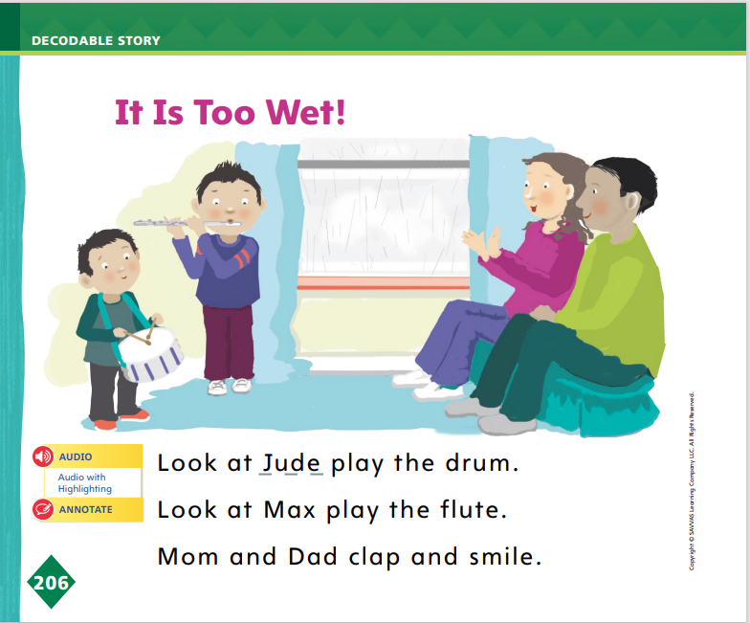
Page 206
Decodable Story
Turn to page 206 in your Student Interactive. Read “It Is Too Wet!” with your partner.
Notes:
Have students turn to p. 206 in the Student Interactive. We are going to read a story today about a family who goes out in the rain. Point to the title of the story. The title is It Is Too Wet! I hear a word with the sound /w/ in the title. What word begins with the sound /w/? Students should say wet. What letter spells the sound /w/? Students should say w.
Remind students of this week’s high-frequency words: say, under, no. Tell them they will practice reading these words in the story. Display the words. Have students read them with you. When you see these words in the story It is Too Wet!, you will know how to Identify and read them.
Have students whisper read the pages as you listen in. Then have students reread the pages with a partner. Listen carefully as they use letter-sound relationships to decode words. Partners should reread the pages. This time the other student begins.

Slide 32
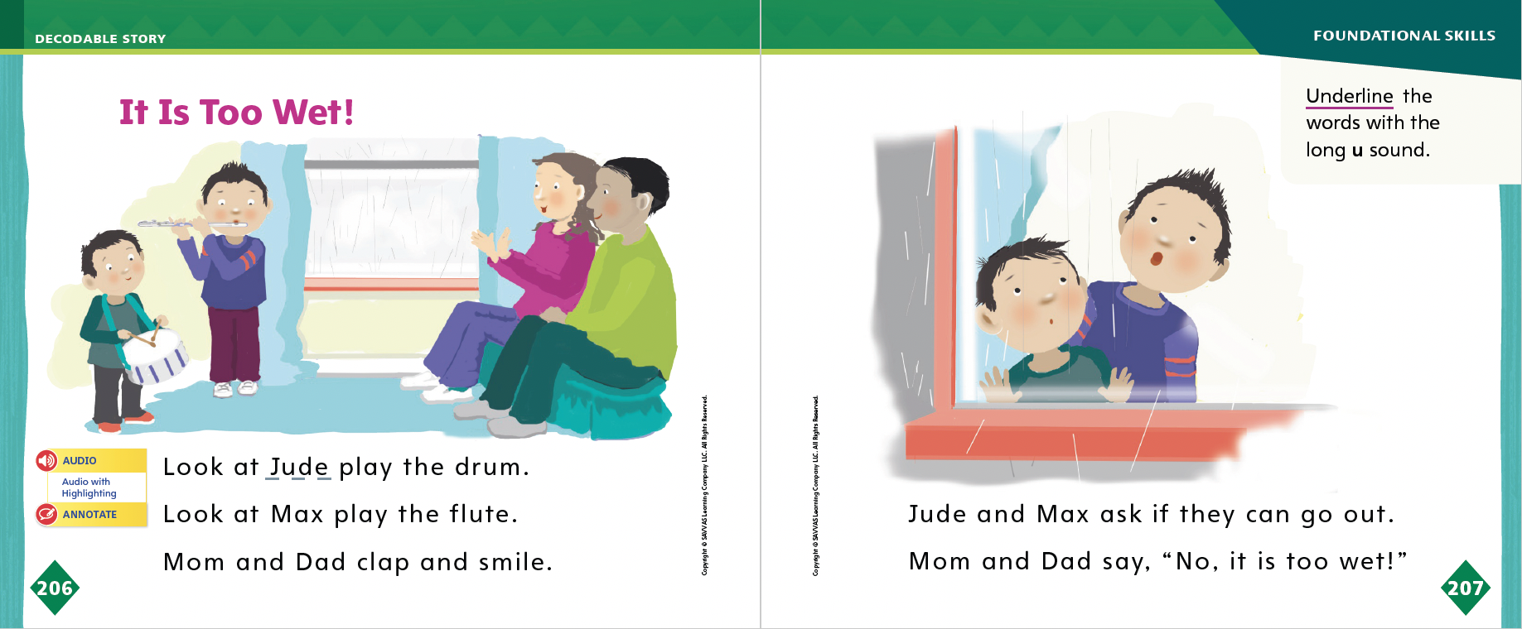
Page 206, 207
Decodable Story
Turn to pages 206-207 in your Student Interactive. Read “It Is Too Wet!” with your partner.
Notes:
After students have read the pages, review the words with the sound /ū/ they read in the sentences on pp. 206–207 in the Student Interactive.
Have them underline the words with the sound /ū/. Have students read the words to you.

Slide 33
Page 208, 209
Decodable Story
Turn to pages 208-209 in your Student Interactive. Read “It Is Too Wet!” with your partner.
Notes:
Have students turn to pp. 208–209. I see words with initial blends. Who can tell me which words have initial blends? Students should identify the words blue, green, skip, and play. Have students highlight blue, green, skip, and play
Remind students of this week’s high-frequency words: say, under, no. I see two high-frequency words we learned this week. Who can point to the words and read them to me? Have a volunteer point to and read the words say and under.
For differentiated support:
If students struggle, revisit instruction in Small Group on pp. T418–T419.
If students show understanding, extend instruction in Small Group on pp. T418–T419.

Slide 34
Spelling
on
zip
leg
trip
Work with a partner to sort the words based on the short vowel spelling pattern.
Notes:
Have students recall how to spell the sounds short o, e, and i.
Read the following words and have students spell them together: on, zip, leg, trip.
Have students sort the words based on the short vowel spelling pattern. (o/o/: on; e/e/: leg; i/i/: zip, trip).
As students work on their writing, remind them to check the spellings of words with short e, i, and o.

Slide 35
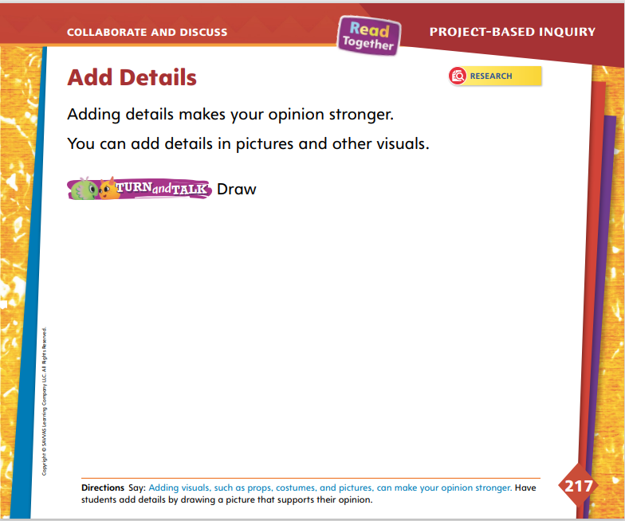
Page 217
Collaborate and Discuss
Turn to page 217 in your Student Interactive.
Notes:
Tell students that they will now draw to support their opinions on their favorite weather or season. Students may wish to revisit their notes to help them add details to their projects. Use the Model and Practice to help students tell and show their opinions.
Direct students’ attention to p. 217 in the Student Interactive. Say: We can improve our persuasive songs or poems by adding details. The details support your opinion. For example, your song or poem may be about how much you love windy days. In the space on page 217, you may choose to draw a picture of a person flying a kite. This detail supports the persuasive song or poem because it shows something special that can be done on windy days. Also, today we will make props, or some kind of object, that goes with our songs or poems. In my example, I may make a kite as a prop. We can also make costumes or any other visuals, such as more drawings, to go with our songs or poems. These extra visual details make our persuasive writing better.
Ask questions to help students create their persuasive text and visuals.
What detail do you want to add?
How would this detail make your opinion stronger?
Is there anything else you could add to make your persuasive poem better?

Slide 36
Page 217
Collaborate and Discuss
Turn to page 217 in your Student Interactive and complete the activity with a partner.
Notes:
Have students work on p. 217. Tell them to support their opinion with details gathered during research. Remind students to consider the audience that they are trying to persuade as they draw and make other visuals. Have students create a neat copy of their persuasive poems on a separate sheet of paper.

Slide 37
Apply
Write a clean, final copy of your persuasive poem to share with your classmates.
Notes:
Have students create a neat copy of their persuasive poems on a separate sheet of paper.
Meet with small groups to review their final drafts. Prompt students to describe what they improved between drafts. Ask: Did you print more carefully in this draft? Did you include spaces between your words? What details did you add to improve your drawing? Accept student responses and point out the positive improvements in students’ final drafts.
For differentiated support:
Have students review their notes on their favorite type of weather or season. Ask: What do you like most about this type of weather? Why is it special? Record students’ responses. Read aloud students’ responses, and guide them to express their opinions. Have them draw their opinions.
If students easily draw and tell their opinions, have them review their notes on their weather topics and choose another fact to draw to support their opinion. Allow students to write words or sentences to label their drawings.
Have students return to the Weather Research Plan on p. 213 in the Student Interactive. Have them check the box that relates to writing or drawing about the weather. Remind them that they will share their persuasive poems or songs with the class.

Slide 38
Lesson 5

Slide 39
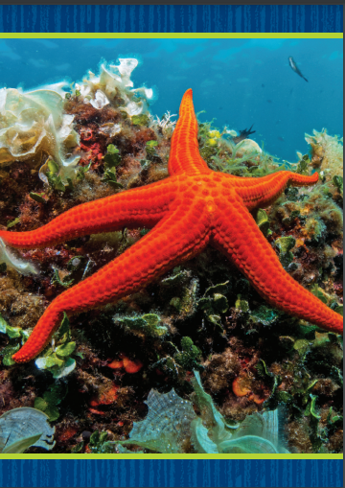
Phonological Awareness
star
+
fish
Notes:
Tell students that today they will continue working with syllables. Ask: What are syllables? Students should say that syllables are word parts.
Hold up a piece of mail and a small box. This is mail. This is a box. Hold the piece of mail and the box together. Listen as I blend the syllables together to make a word: mailbox. Move the mail and the box apart. Listen as I break the word apart again: mail (pause) box. Have students blend and segment the syllables in the word mailbox as you hold together and separate the piece of mail and the box.
Provide students with picture pairs, such as star, fish; book, shelf; and foot, ball. Have students identify the individual syllables shown in the pictures. Then have them blend and segment the syllables as they hold together and separate the pictures. Click path -> Table of Contents -> Unit 5 Week 6 Project-Based Inquiry -> Lesson 5

Slide 40
Page 210
Phonics
Turn to page 210 in your Student Interactive.
Notes:
Tell students that today they will read some sentences. Remind them that sentences are made up of words separated by spaces. Say: The sentences we read will all include sound-spellings and high-frequency words you already have learned.
Have students turn to p. 210 in the Student Interactive. Ask them to point to the spaces between the words in the first sentence. Say: Now let’s read the first sentence together: Set it on the plate. Look at the pictures. What do they show? Students should say an apple on a table and an apple on a plate. Which picture matches the sentence Set it on the plate? Students should say the picture of the apple on the plate.

Slide 41
Page 210, 211
Apply
Turn to pages 210-211 in your Student Interactive and complete the activities.
Notes:
Guide students as they use letter-sound relationships to decode words and complete the activities on pp. 210–211 in the Student Interactive

Slide 42
High-Frequency Words
say
under
no
Notes:
Remind students that high frequency words are words that appear over and over in texts.
Say the word say and ask students what letters spell the word.
Have students
read the word aloud.
say the letters as you write them on the board.
repeat with under and no.

Slide 43
Spelling
The dog will sit down.
Put the can on the shelf.
Where can I see an ox?
We started to clap.
She had a lot to say.
He said there were no grapes left.
Notes:
(Note: Move the orange boxes to cover each bold spelling word before you read aloud the words and sentences.)
Read aloud the words and sentences. Have students spell the words with the sound /kw/, the other spelling words, and the two high-frequency words.
The dog will sit down.
Put the can on the shelf.
Where can I see an ox?
We started to clap.
She had a lot to say.
He said there were no grapes left.
Reveal the spelling word and have students check their work.

Slide 44
Page 218
Celebrate and Reflect
Turn to page 218 in your Student Interactive.
Present your persuasive poem to your classmates as you follow the rules for speaking and listening.
Notes:
Tell students that they will share their research projects with the class. Explain that there are different ways for them to share their projects, such as performing their songs or reading or showing their poems and drawings.
Give students time to practice their presentations with partners.
Tell students to speak loudly and clearly. Remind them to practice showing their writing or drawings as they speak.
Use the Active Listening Routine to help students be good listeners.
Model the active listening routine to set expectations for audience members.
Look Look at the person who is talking. Do not talk.
Think Think about what the person is saying.
Respond Raise your hand when you have a question. Clap when the speaker is finished.

Slide 45
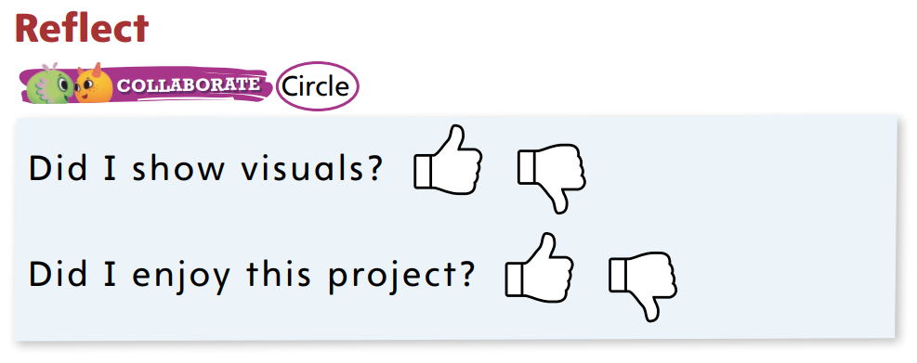
Page 218
Celebrate and Reflect
Turn to page 218 in your Student Interactive and complete the activity.
Notes:
Guide students to complete the activity at the bottom of p. 218 in the Student Interactive.
Allow time for students to reflect on the steps of the project. Help students recall how they asked questions, gathered information, drafted an opinion through poetry or song, and shared their projects.
Guide students to ask themselves questions, such as: What was my opinion? How did I express my opinion? What details did I add to make my persuasive text better?

Slide 46
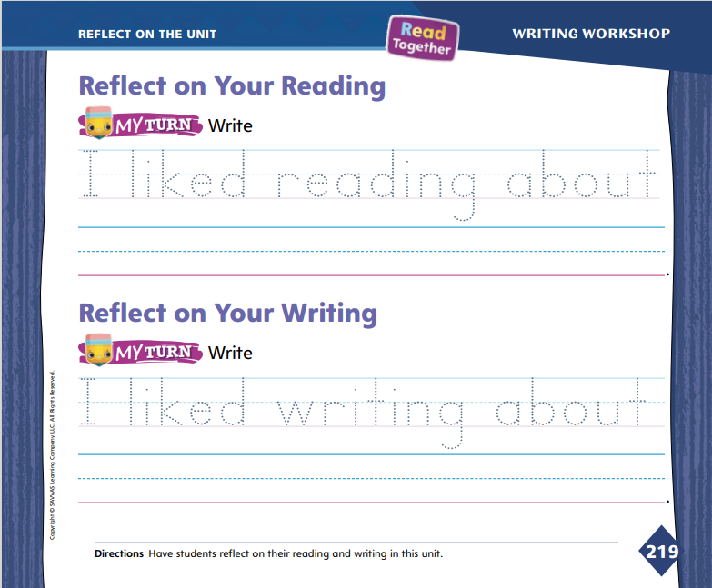
Page 219
Reflect on the Unit
Turn to page 219 in your Student Interactive and complete the activities.
Notes:
With students, review the Unit Goals page at the beginning of the unit. Have students reflect on their reading and writing skills. Review and discuss the Essential Question: What can we learn from the weather?
Display the unit readings. Ask volunteers to briefly talk about each reading selection. Ask other volunteers to offer thoughts and opinions about the selection, such as: I liked to read about ______. I think this reading was the best because ______.
Have volunteers tell what they learned about writing. Ask students to tell about their favorite writing. Use prompts, such as: What kind of writing did you like best? What kind of writing would you like to do again?
Invite students to identify their opinions on a text from the unit and their favorite piece of writing. Direct students to trace the dotted letters under each Reflect activity on p. 219 in the Student Interactive. Help them record their responses on the lines.

Slide 47
Unit 5: Week 6
Kindergarten

